Slide 1
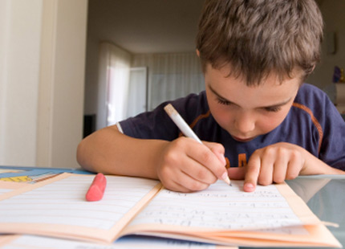
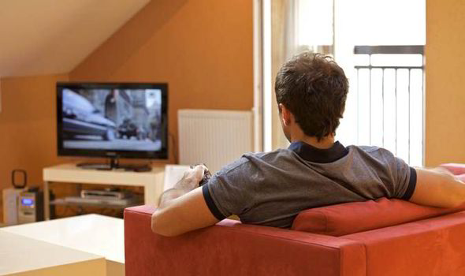

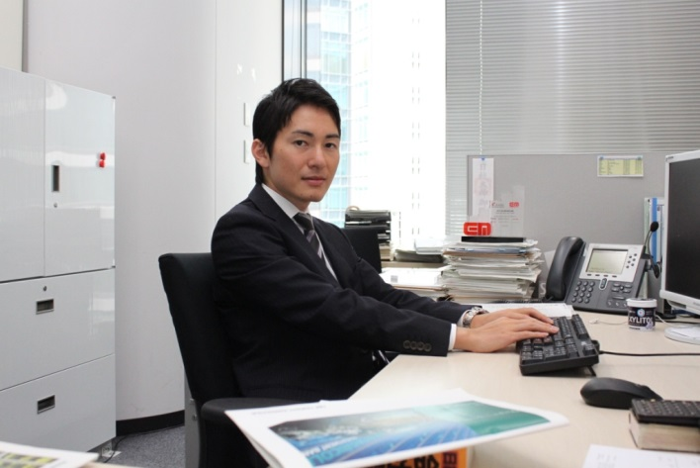
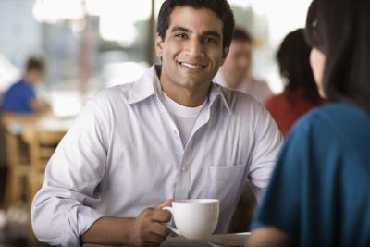
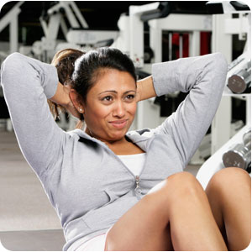
Do homework
Work
Exercise
Watch tv
Have coffee
Check email

Slide 2
Present simple
(HE/SHE/IT)
Let’s see the rules

Slide 3
In the simple present for he/she/it we need to add «s» or «es» to the verb.
Let’s see the rules

Slide 4

Spelling rules
01
General rule
He works
She begins
It runs
You have to add «s» at the end of the verb.

Slide 5
Spelling rules
02
Second rule
He goes
She washes
It watches
He fixes
She guesses
You have to add «es» at the end of the verb. When the verbs finish by:
–ch
-ss,
Sh
-o
-x

Slide 6
Spelling rules
03
Third rule
When a verb finishes by a consonant and «y» you have to change the «y» into «i» then you have to add «es» --- «ies»
EXAMPLES:
He (study) ------ He studies
She (carry)-------She carries
It (fly) ------------- It flies

Slide 7
Affirmative
I play basquetball.
You play tennis.
He/She/ it watches tv.
We listen to music.
You dance.
They sleep.

Slide 8
PRACTICE
I – YOU- HE-THEY
watch – play – wash – study
football/ TV/ English/ the hands
1. WE DRINK MILK.
2.
3.
4.
5

Slide 9
NEGATIVE
I don´t play basquetball.
You don´t play tennis.
He/She/ it doesn´t watch tv.
We don´t listen to music.
You don´t dance.
They don´t sleep.

Slide 10
PRACTICE
I – YOU- HE-THEY
watch – play – wash – study
football/ TV/ English/ the hands
1. WE DON´T DRINK MILK.
2.
3.
4.
5

Slide 11
Interrogative
Do I dance?
Do you wacth tv.?
Does she, he, it listen to music ?
Do we play tennis?
Do you clean the house?
Do they wash the dishes ?

Slide 12
PRACTICE
I – YOU- HE-THEY
watch – play – wash – study
football/ TV/ English/ the hands
1. DO WE DRINK MILK?
2.
3.
4.
5

Slide 13



Affirmative sentence structure
1
2
3
Subject
Verb
complement
She watches Tv
He goes to the park
It drinks milk

Slide 14
Negative sentence structure
1
2
3
4
Subject
Doesn’t
verb
complement
She doesn’t watch Tv
He doesn’t go to the park
It doesn’t drink milk

Slide 15
LET´S PRACTICE

Slide 16
Affirmative | Negative | Interrogative
He plays basketball | He doesn´t play basketball | Does he play basketball?

Slide 17
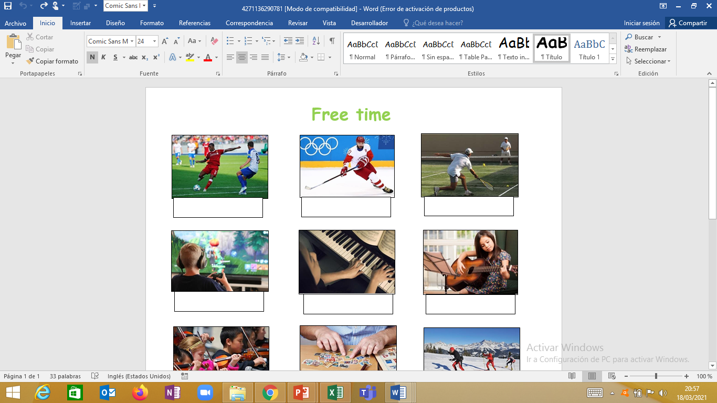
They
He
They
play ice hockey
play tennis
play football

Slide 18
He
They
She
play the guitar
play computer games
play the piano

Slide 19
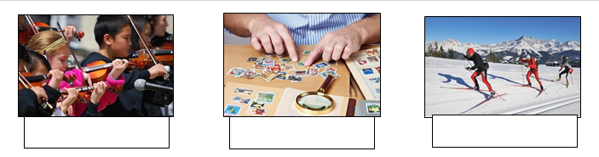
They
He
We
play the violin
collect stamps
go skiing

