Slide 1
VOCABULARY
DAYS OF THE WEEK
MONTHS OF THE YEAR
SEASONS

Slide 2
DAYS OF THE WEEK

Slide 3
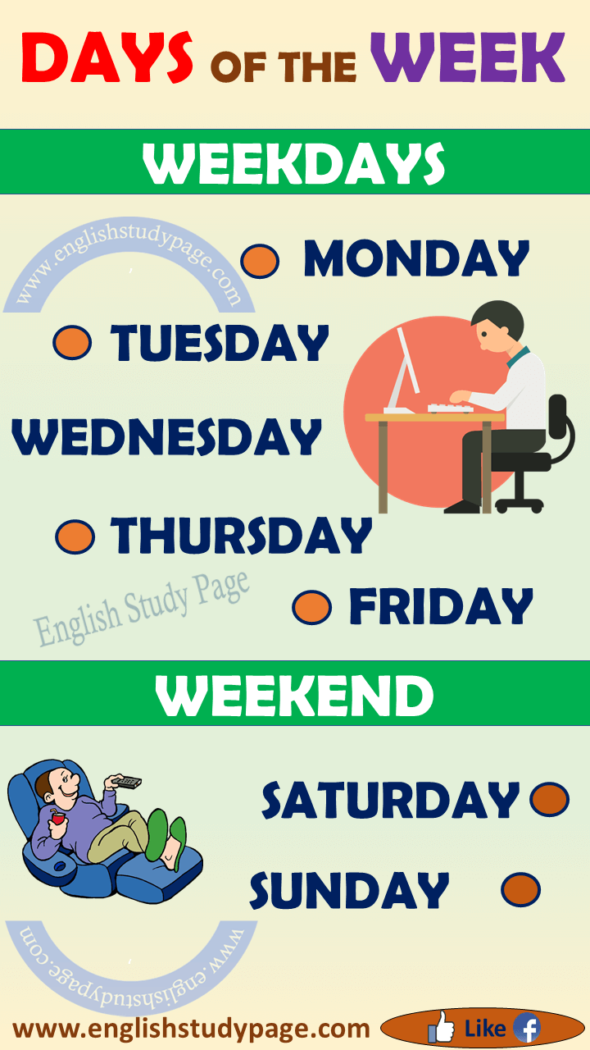

Slide 4
Months of the year

Slide 5


Slide 6
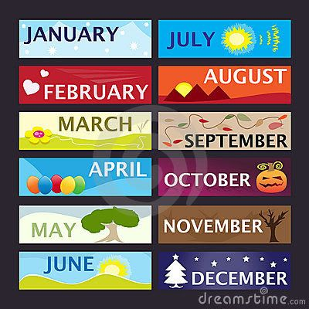

Slide 7
SEASONS

Slide 8
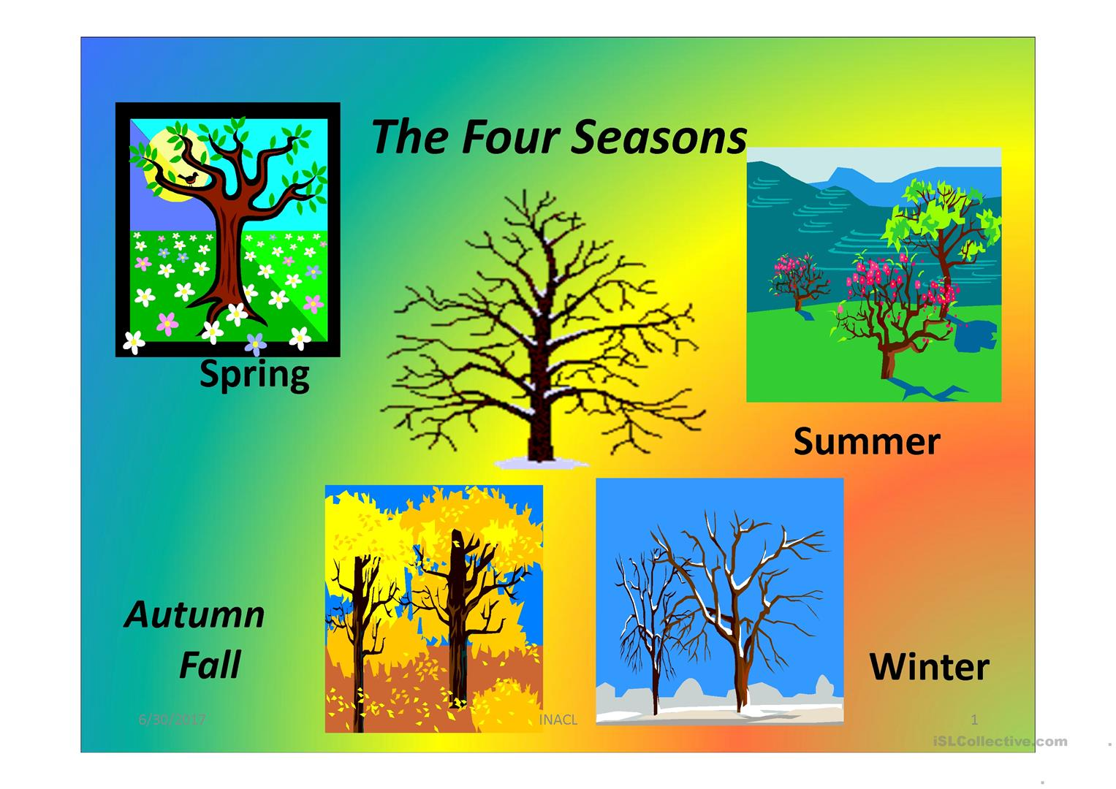

Slide 9
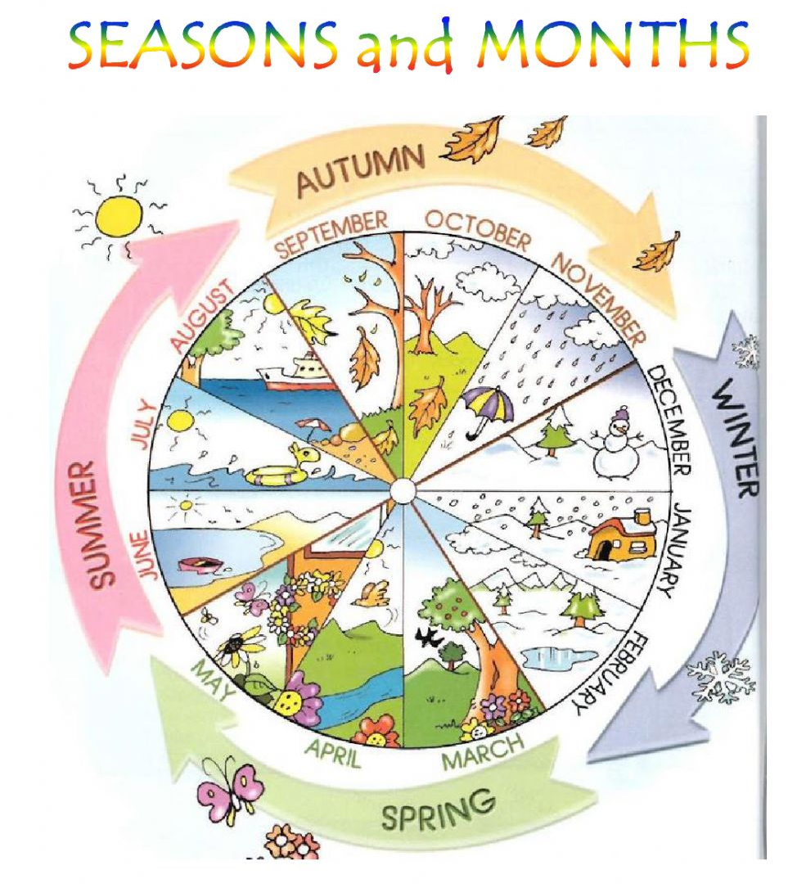

Slide 10
Thanks for your attention

