Slide 1
Everyday life
Unit 4

Slide 2
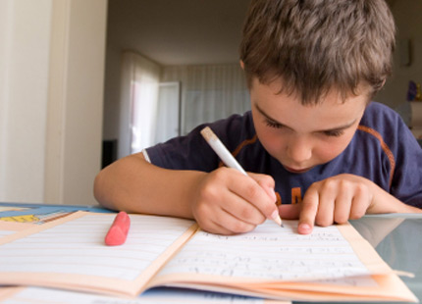
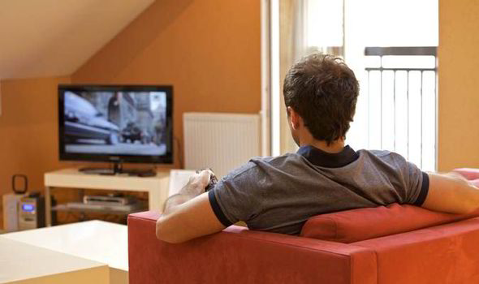
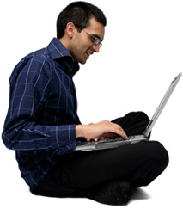
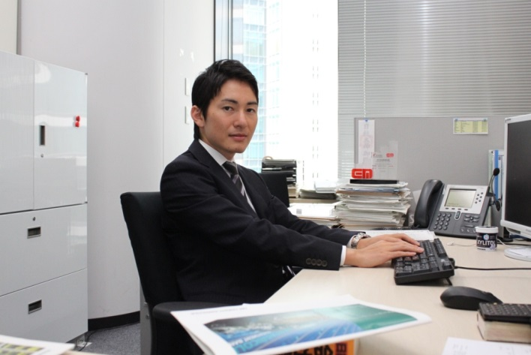

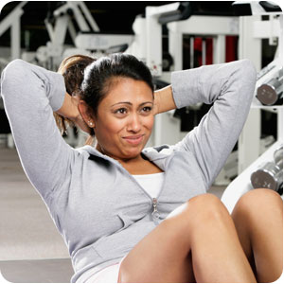
Do homework
Work
Exercise
Watch tv
Have coffee
Check email

Slide 3
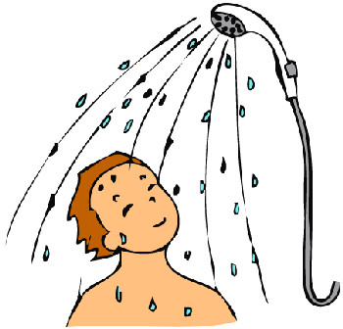
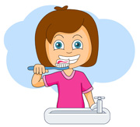
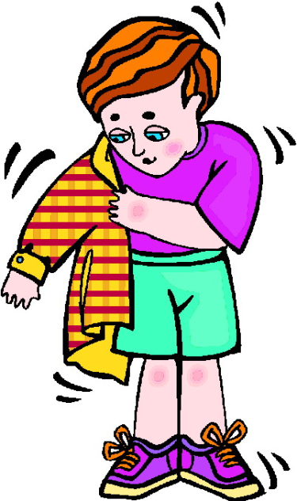

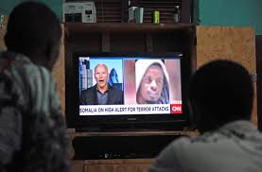

Slide 4
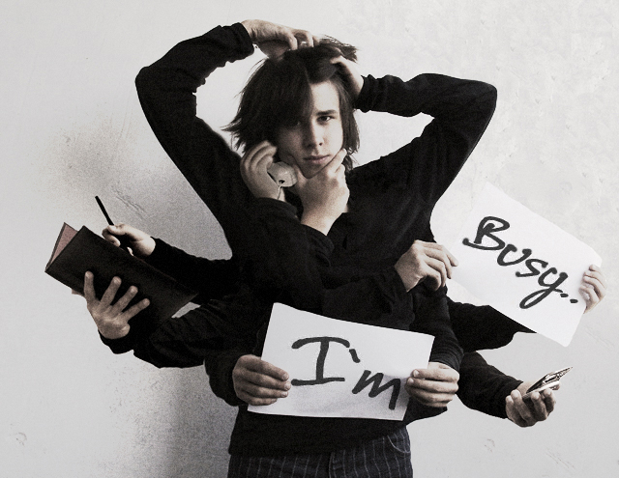
Pretty busy

Slide 5
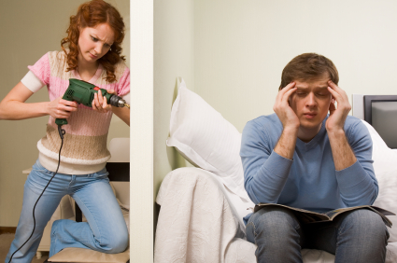
Noisy

Slide 6
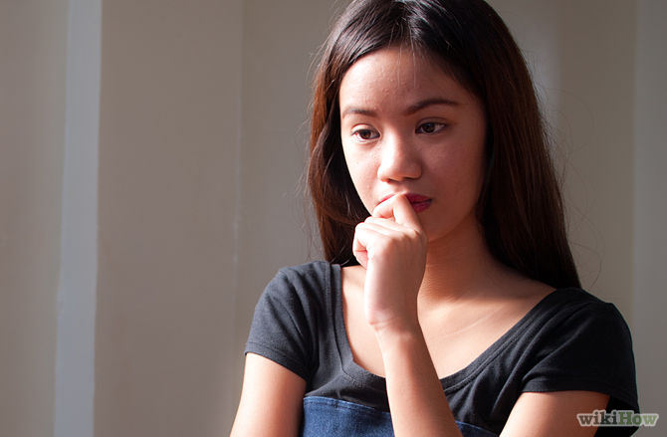
Pretty quiet

Slide 7
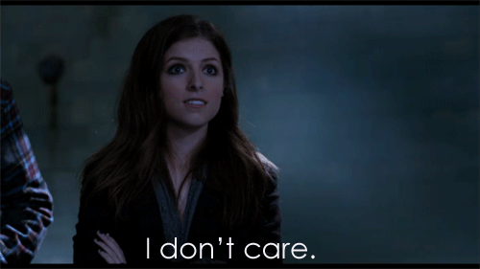
I don’t care

Slide 8
Simple present
Affirmative sentence | Negative sentence
I eat breakfast. | I don’t eat lunch.
You have coffee. | You don’t have tea.
We get up late. | We don’t get up early.
They read the paper. | They don’t read books.
He listens to the radio. | He doesn’t listen to CDs.
She watches tv. | She doesn’t watch videos.
Don’t= do not
Doesn’t= does not

Slide 9
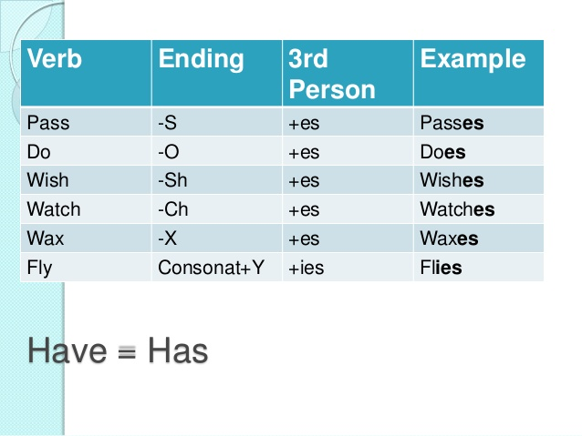
Verb endings: he, she, it

Slide 10
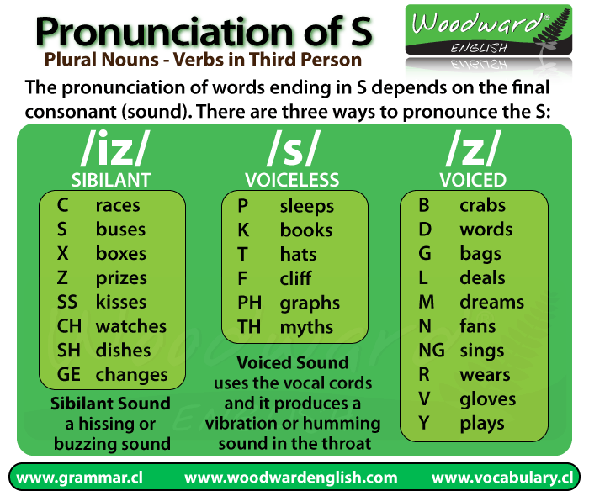

Slide 11
Lesson b

Slide 12
Time expressions
On Monday (s)
On (the) weekend(s)
In the morning(s)
In the afternoon (s)
In the evening (s)
At night
Before breakfast
After class
Every day

Slide 13
Yes-no questions
Do you go to a class in the evening?
Do you and your friends play sports after class?
Do your friends make phone calls at night?
Does your mother work on the weekends?
Yes, i do. / No, i don’t
Yes, we do. /No, we don’t.
Yes, they do. / No, they don’t.
Yes, she does. / No, she doesn’t.

Slide 14
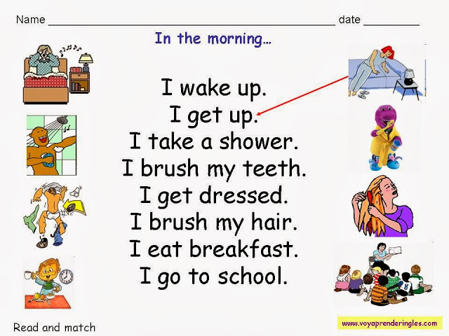

Slide 15
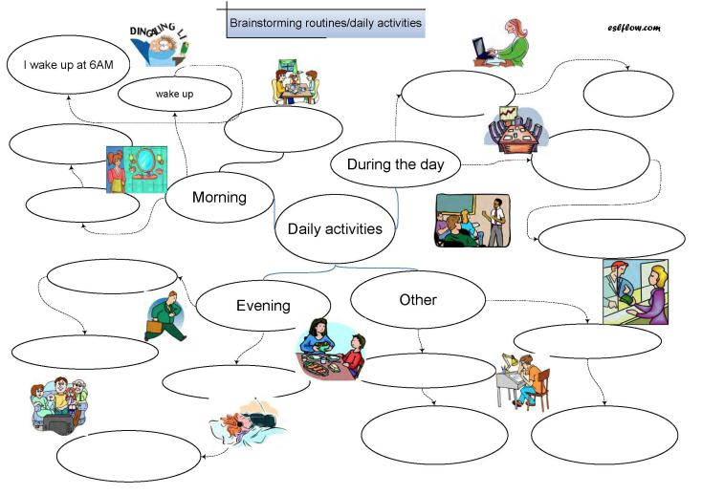

Slide 16
