Slide 1
Conditional Zero

Slide 2
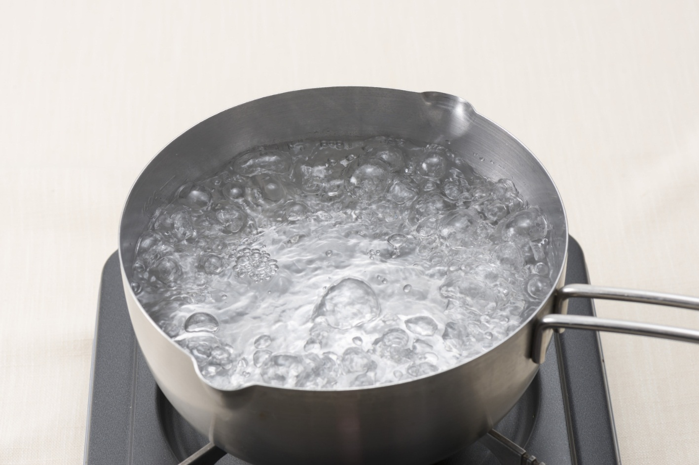
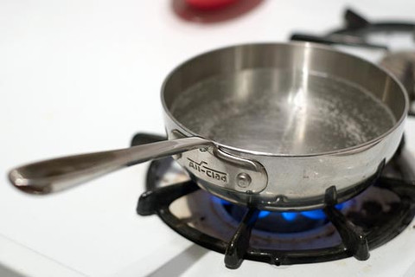
If you heat water,
it boils.
Water boils if you heat it.

Slide 3
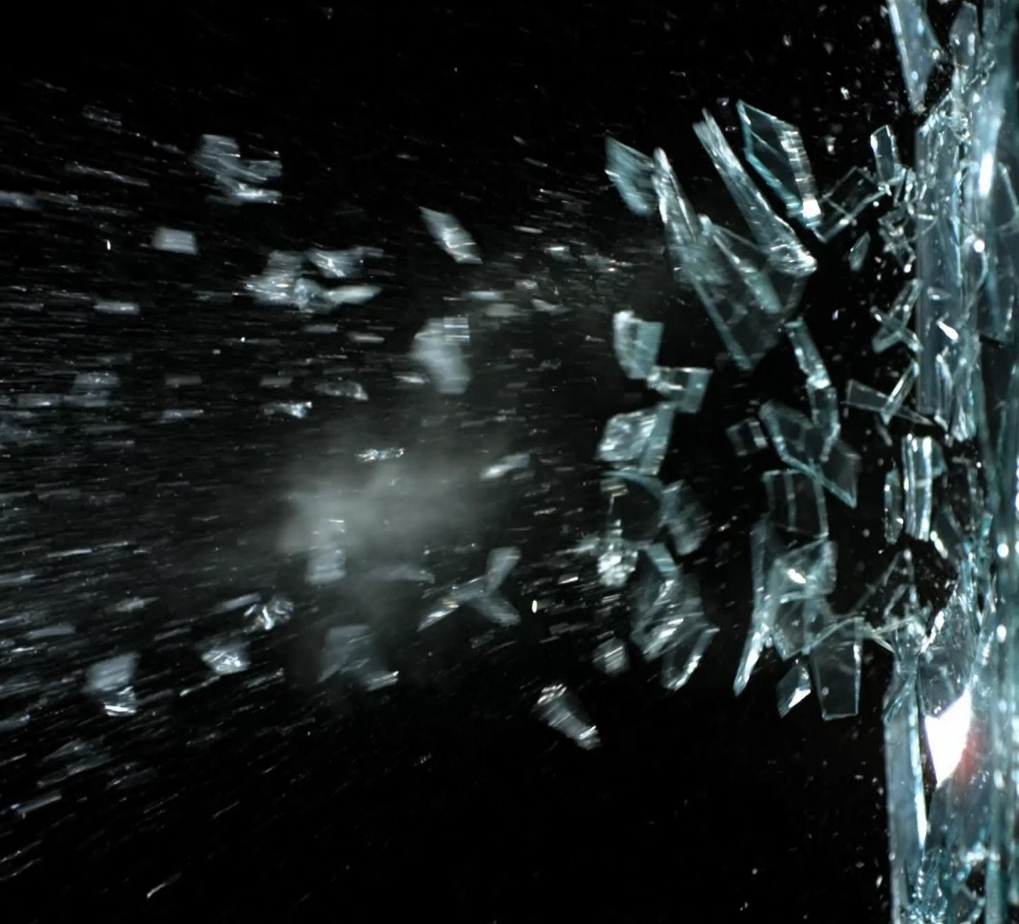
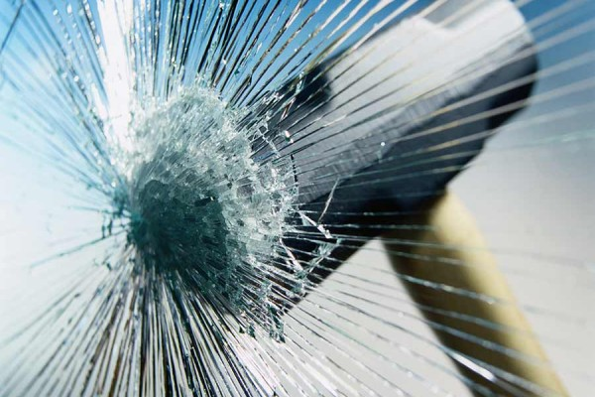
If you hit glass,
it breaks.
The glass breaks if you hit it.

Slide 4

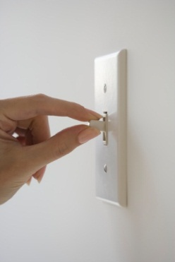
If you flip the switch,
the light switches on.
The light switches on if you flip the switch.

Slide 5
If people eat too much, they get fat.
If you touch a fire, you get burned.
People die if they don't eat.
Snakes bite if they are scared.
If babies are hungry, they cry.

Slide 6
If you hit glass, it breaks.
Water boils if you heat it.
If clause
Main clause
Main clause
If clause

Slide 7
Conditional Zero
If you heat water, it boils.
If clause
Main clause
You can also start with the main clause followed by the if clause.
Water boils if you heat it
Main clause
If clause
If clause | If + Subject + verb in the present simple
Main clause | Subject + verb in the present simple
USE: We use conditional zero for:
Things that always happen if something happens first.
Instructions and advice: If you are sick, visit a doctor. If the door is closed, call me.

Slide 8

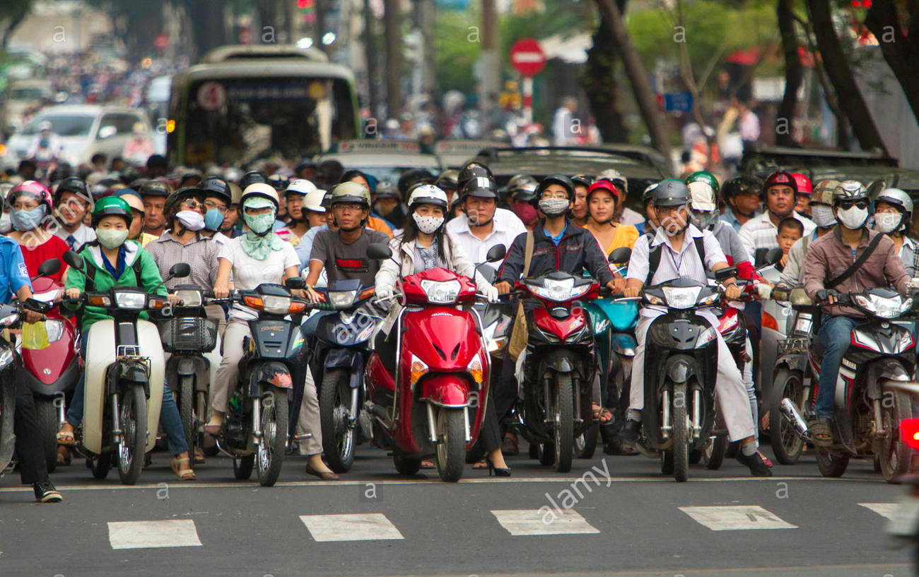
If
stop
red light
they
see
drivers
.

Slide 9

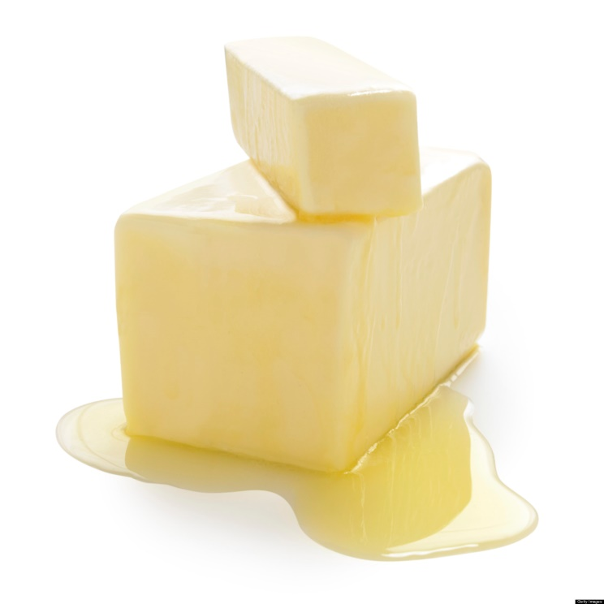
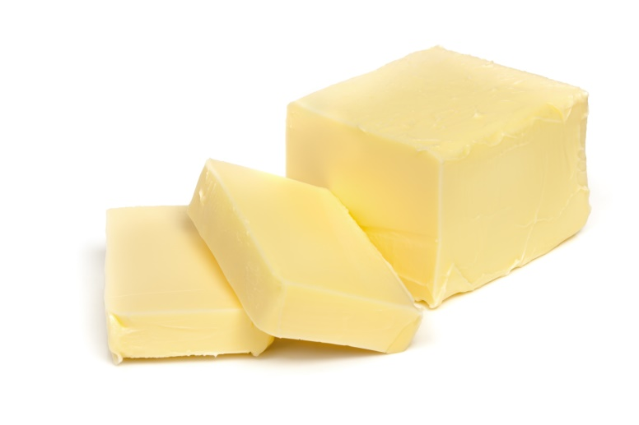
If
melts
you leave
in the sun
it
butter
.

Slide 10

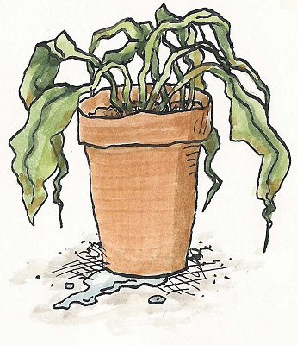

If
doesn’t water
the plants
they
my mom
die

Slide 11
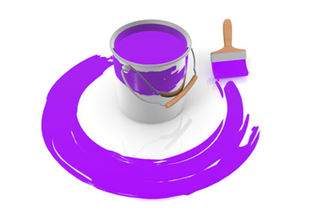
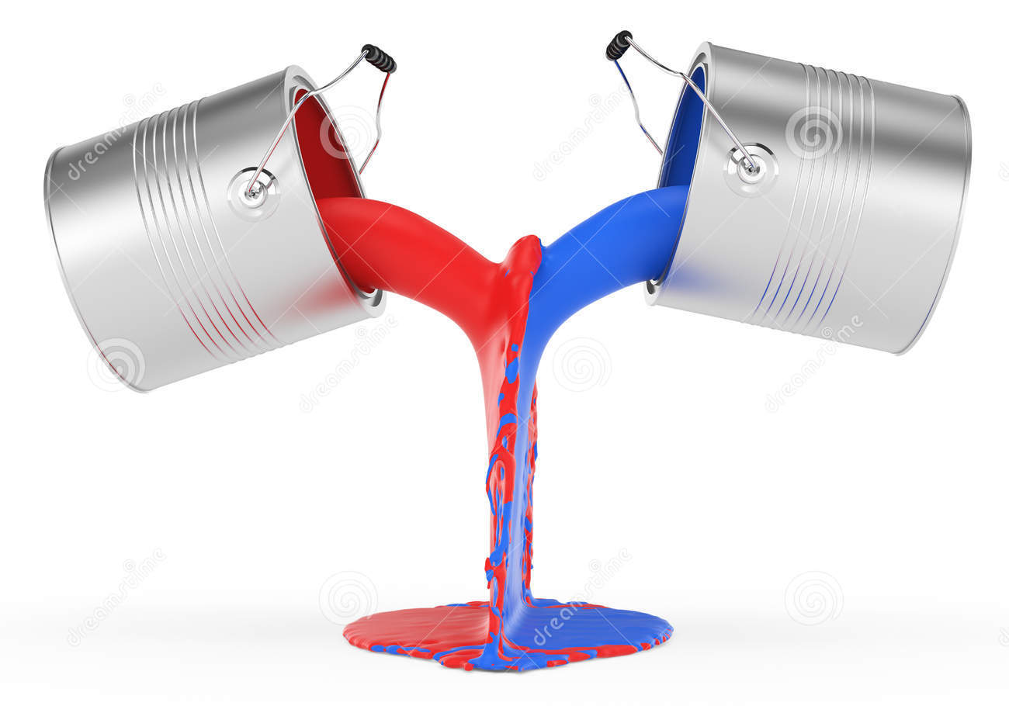
purple
If
you
you
mix
red and blue
get

Slide 12
Make a zero conditional sentence using the words.
For example: "water / boil / heat "
Water boils if you heat it.
ice / float / you / drop / it / in water
:
you / not / eat / you / die
:
my daughter / eat / too much chocolate / she /get / sick
:
You / lost / ask / for / help
:
Ice floats if you drop it in water.
.
.

Slide 13
Complete the zero conditional sentences with the verb in brackets
If ………………….. (I / go) on a boat, I always feel sick.
The teacher gets angry if …………………………. (we / not / work) hard.
It's easier to sleep if ………………………… (you / not / be) stressed
His mother gets annoyed if ………………………… (he / be) late.
If………………………………. (I / not / know) a word, I look in my dictionary.
They play football if …….……………………….. (they / not / have) any homework.
If you freeze water, ……………………………………. (it / turn) to ice

Slide 14
(I / wake up late / I / be late for work) ___
(my husband / cook / he / burn the food) ___
(Julie / not wear a hat / she / get sunstroke) __
(children / not eat well / they / not be healthy)__
By EFLSheets

Slide 15
(you / mix water and electricity / you / get a shock) ___
(people / eat / too many sweets / they / get fat)_____
(you / smoke / you / get yellow fingers) _
(children / play outside / they / not get overweight)

