Slide 1



by HERBER

Slide 2

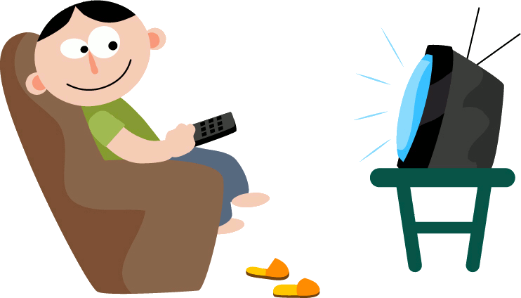
AFFIRMATIVE
Affirmative
S+ WAS/WERE+ VERB+ ING+ COMP
Negative
S+ WAS/WERE+ NOT + VERB+ ING+ COMP
INTERROGATIVE
WAS/WERE+ S+ VERB+ ING+ COMP ?
She was playing in the park.
They were eating seafood.
I was
watch
ed
ing
watch
ed
ing
You were
watch
ed
ing
He was
She was
watch
ed
ing
It was
watch
ed
ing
We were
watch
ed
ing
watch
ing
You were
ed
They were
watch
ed
ing

Slide 3
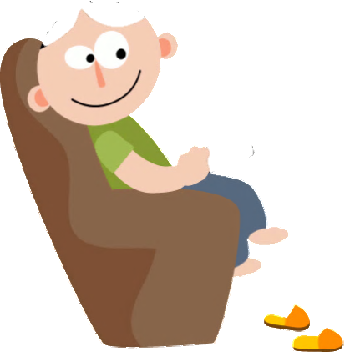
NEGATIVE
I was not watching
wasn’t
You were not watching
weren’t
wasn’t
He was not watching
She was not watching
wasn’t
It was not watching
wasn’t
We were not watching
weren’t
You were not watching
weren’t
They were not watching
weren’t

Slide 4
INTERROGATIVE
QUESTIONS
SHORT ANSWERS
Was I
I
was
watching
?
Yes, I was/you were
No, I wasn’t/you weren’t
Were you
You
were
watching
?
He
was
Was he
watching
?
She
was
?
Yes, he/she/it was
No, he/she/it wasn’t
Was she
watching
Was it
It
was
watching
?
Were we
We
were
watching
?
Yes, we/you/they were
No, we/you/they weren’t
Were you
You
were
watching
?
Were they
They
were
watching
?

Slide 5

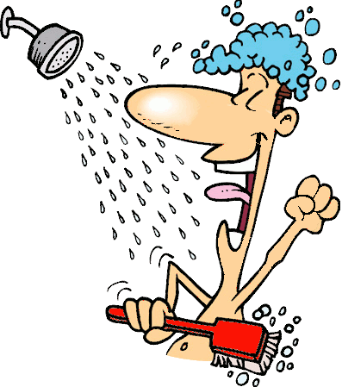

What was he doing yesterday at 7 a.m.?
He was having a shower

Slide 6
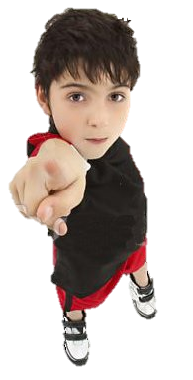
What were you doing yesterday at 7 a.m.?
I was helping to cook

Slide 7


What was he doing yesterday at 7.30 a.m.?

Slide 8
What were you doing yesterday at 7.30 a.m.?

Slide 9
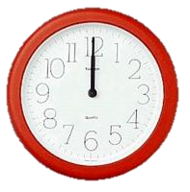
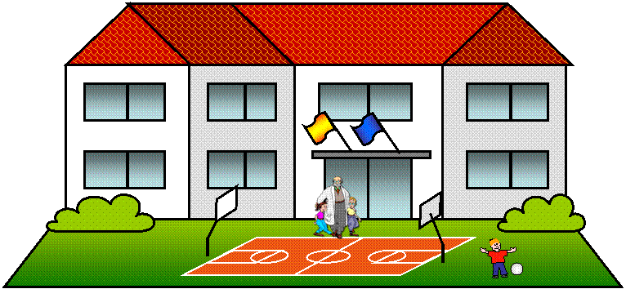
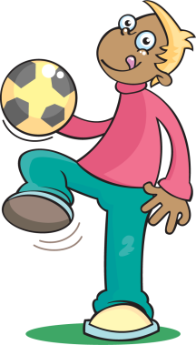
What was he doing yesterday at noon?

Slide 10
What were you doing yesterday at noon?

Slide 11


What was he doing yesterday at 4 p.m.?

Slide 12
What were you doing yesterday at 4 p.m.?

Slide 13

What was he doing yesterday at 9 p.m.?

Slide 14
What were you doing yesterday at 9 p.m.?

Slide 15
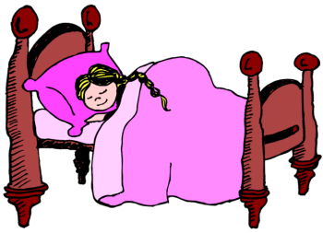

Was she watching TV yesterday at midnight?
No, She wasn´t

Slide 16
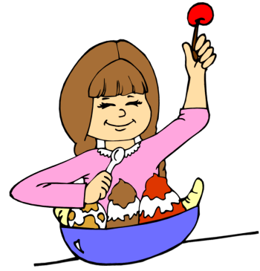
Was she having dinner yesterday at 9 p.m.?
Yes, she was

Slide 17
Were you having a bath yesterday at midnight?

Slide 18
What were you
reading last month?

Slide 19
What were you doing before this class ?

Slide 20
What were you doing before you went to bed yesterday?

Slide 21
What were you doing last Sunday morning?

Slide 22
What were you doing yesterday while your mother or father was cooking?

Slide 23
What were you doing yesterday afternoon when your mother or father arrived home?

