Slide 1

SECOND CONDITIONAL
UNREAL FACTS
WISHES
EXPECTATIONS

Slide 2
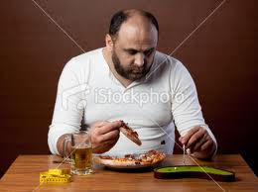
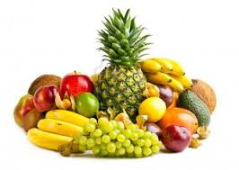
IF I WERE YOU….
I WOULD EAT HEALTHY FOOD SUCH AS FRUITS, VEGETABLES AND NUTS

Slide 3
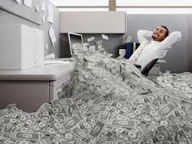
IF I HAD MONEY…
I WOULDN’T WORK ANYMORE IN MY LIFE.

Slide 4
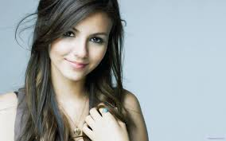
IF SHE WERE MY GIRLFRIEND…
I WOULD BE HAPPY….

Slide 5
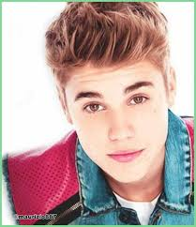
IF JUSTIN BIEBER CAME TO BARRANQUILLA…
I WOULD GO TO HIS CONCERT..

Slide 6
SECOND CONDITIONAL STRUCTURE
IF + SIMPLE PAST VERBS
WOULD + VERB
IF I HAD MONEY
I WOULD TRAVEL AROUND THE WORLD…
IF SHE TOLD ME LIES
I WOULD GROUND HER

Slide 7
If I were taller, she would like me. (Si fuera más alto, le gustaría.)
If I won the lottery, I would buy my dream house. (Si ganara la lotería, compraría la casa de mis sueños.)
If she lost weight, the dress would fit. (Si perdiera peso, el vestido le quedaría bien.)
If we lived in France we would learned French very fast. (Si viviéramos en Francia aprenderíamos francés muy rápido.)
If they were in our place, they would do the same thing. (Si estuvieran en nuestro lugar, harían lo mismo.)
If i were a good player, I would play in a famous team.
If I lived in china, I would eat food with chopsticks.
If I lived in France, I would visit the Eifel tower
If I finished my studies, I would get a good job.
If she practiced a lot, She would be an excellent dancer
I would visit the Eifel tower if i lived in France
She would be an excellent dancer if she practiced a lot.
Fuente: https://www.ejemplos.co/20-ejemplos-de-second-conditional-en-ingles/#ixzz6fwvyq7yJ

