Slide 1
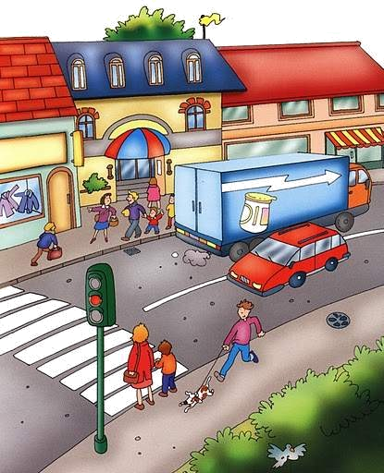
PLACES IN TOWN

Slide 2
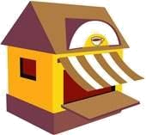

RESTAURANT
CAFÉ
HOTEL

Slide 3
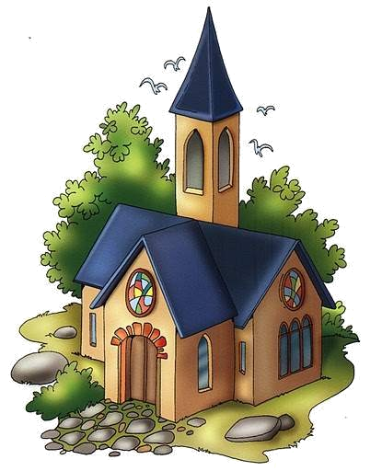
CHURCH
SCHOOL
RESTAURANT

Slide 4
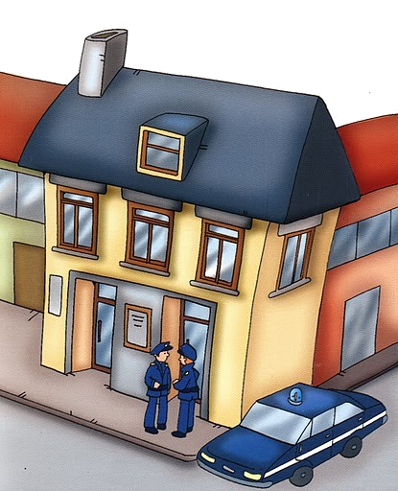
HOTEL
HOSPITAL
POLICE STATION

Slide 5
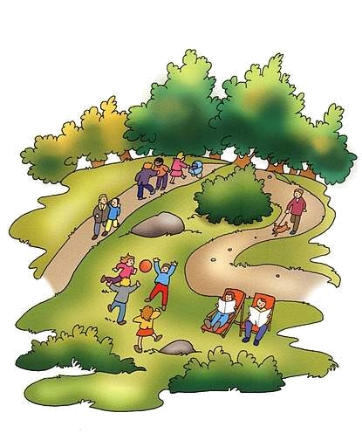
BUS STOP
PARK
CHURCH

Slide 6
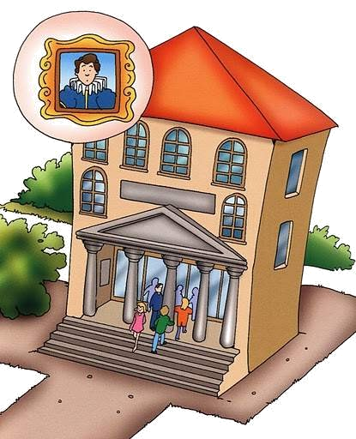
MUSEUM
BAKER’S
BUTCHER’S

Slide 7
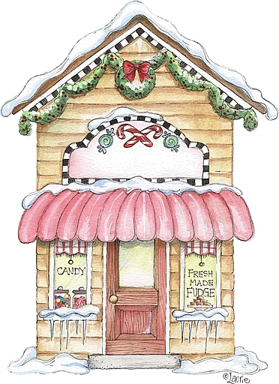
BAKER’S
COFFEE SHOP
CANDY SHOP

Slide 8
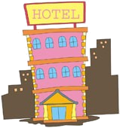
HOTEL
SCHOOL
CAFÉ

Slide 9
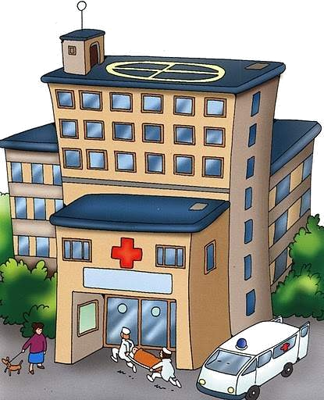
HOSPITAL
HOTEL SCHOOL

Slide 10

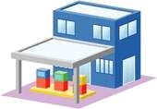
PETROL STATION
TRAIN STATION
BUS STATION

Slide 11
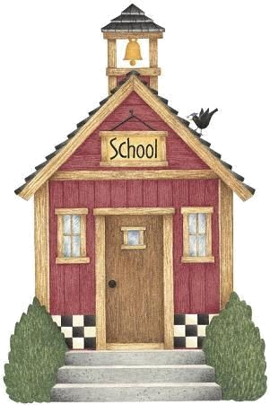
POLICE STATION
HOSPITAL
SCHOOL

Slide 12
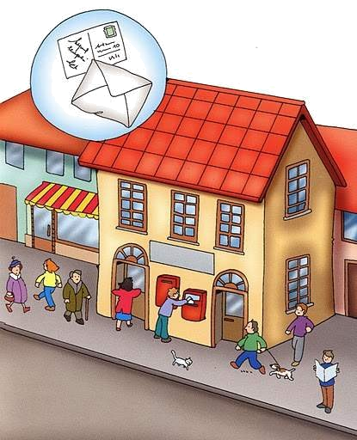
BUTCHER’S
POST OFFICE SCHOOL

Slide 13
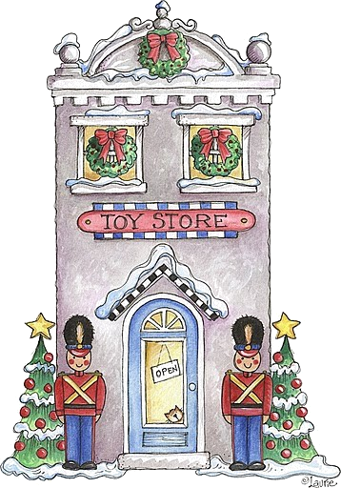
PARK
ZOO
TOY STORE

Slide 14
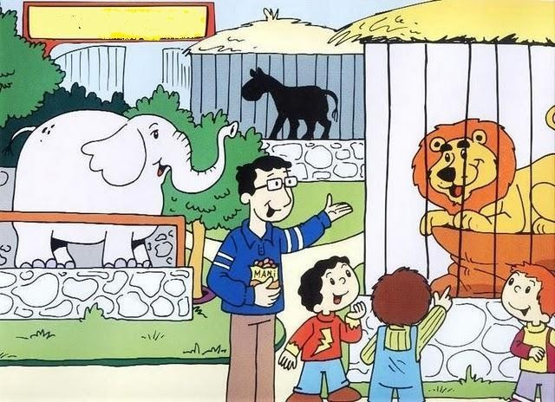
SCHOOL
ZOO CHURCH

Slide 15
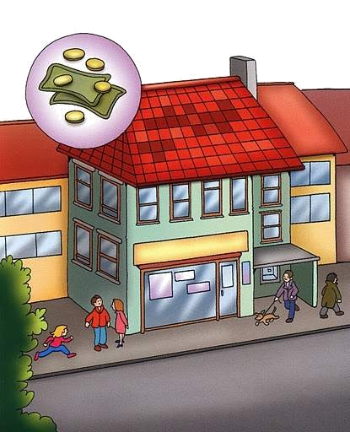
BANK
SCHOOL CHURCH

Slide 16
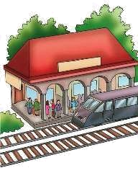
BUS STATION
TRAIN STATION
POLICE STATION

Slide 17
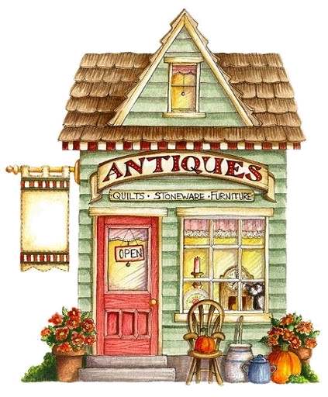
ANTIQUE SHOP
FLOWER SHOP
SHOE SHOP

Slide 18
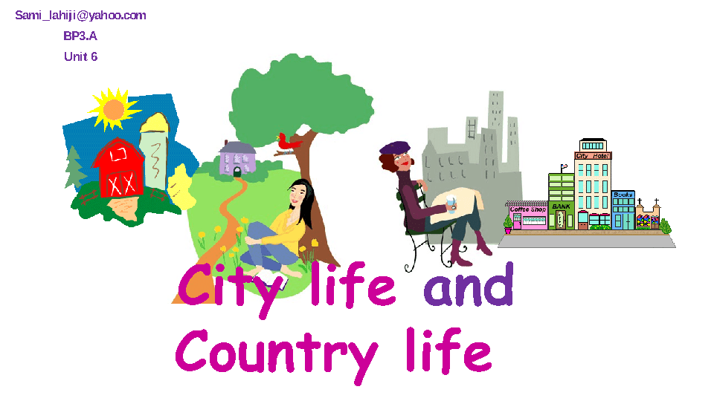
DIFFERENCES BETWEEN COUNTRYSIDE AND CITY

Slide 19
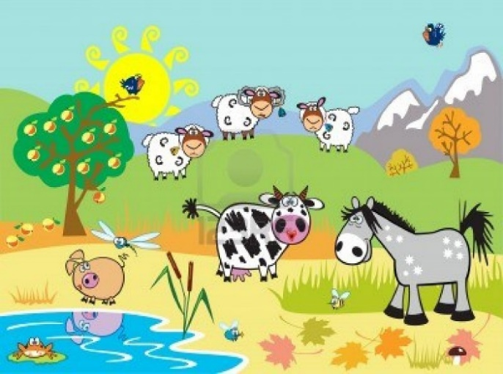
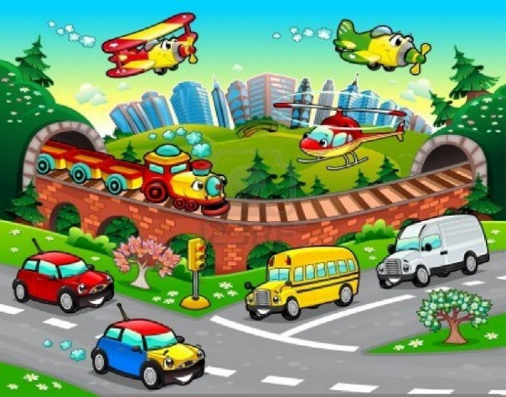
quiet – big – beautiful – bad - clean - noisy - healthy – good - interesting – pretty - loud
The country is cleaner than the city.
The city is bigger than the country.

